Slide 1
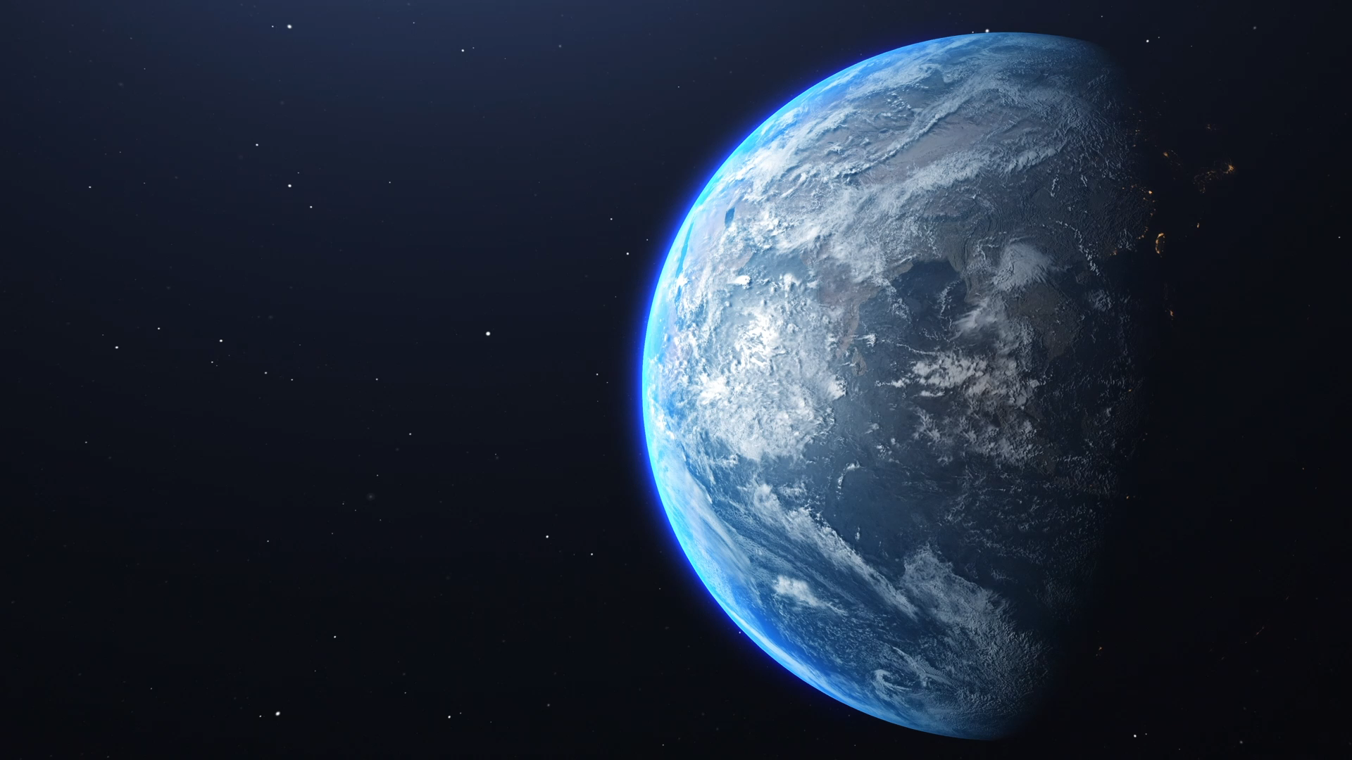


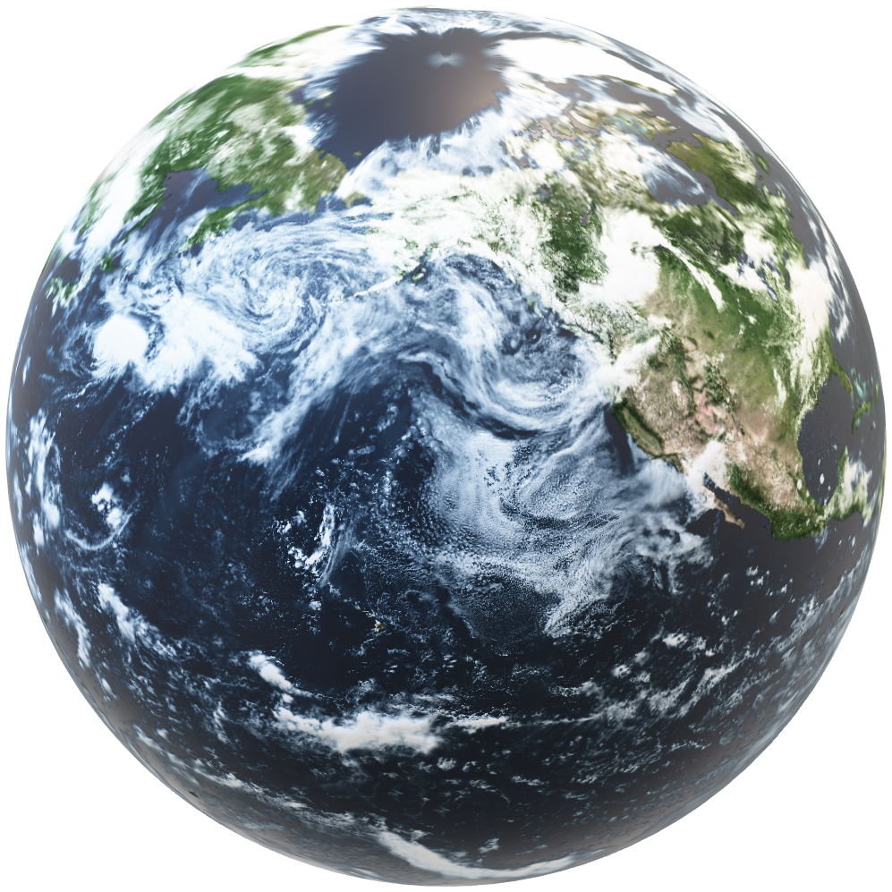
Introduction to
Google Earth Engine
Coastal Vulnerability Mapping and analysis using QGIS
Gaurav Khairnar
Project Scientist
Email: gb.khairnar-p@incois.gov.in
Indian National Center for Ocean Information Services (INCOIS)
Hyderabad

Slide 2
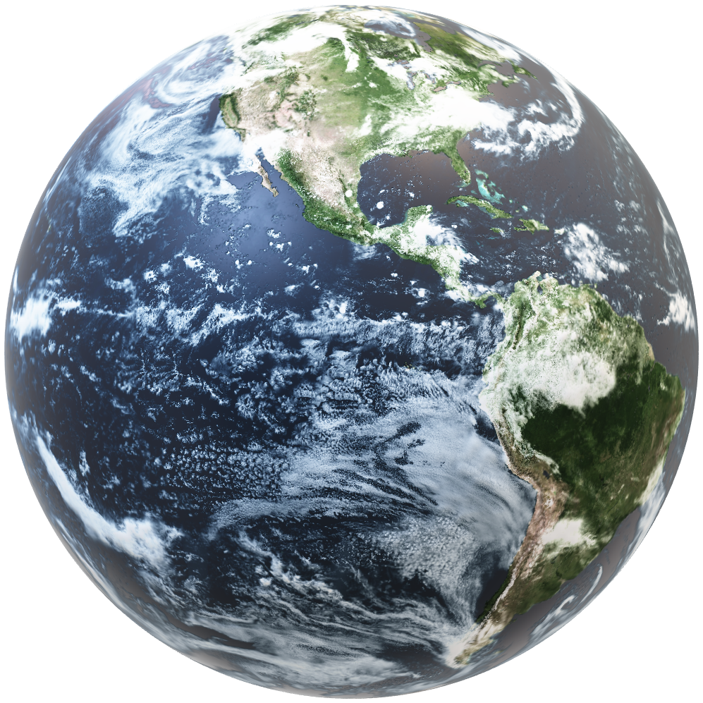
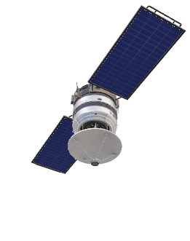
Outline
Introduction
Datasets and ImageCollections
Working with Google Earth Engine
Data management and analysis
Importing and exporting data
Spectral signatures and timeseries
Google Earth Engine Cloud-based platform combines multi-petabyte catalog of satellite imagery and geospatial datasets with large-scale geospatial analysis
Access over 40 plus years of data
The Earth Engine API is available in Python and JavaScript, making it easy to harness the power of Google’s cloud for your own geospatial analysis.
No need of satellite data downloading, processing, storage…

Slide 3
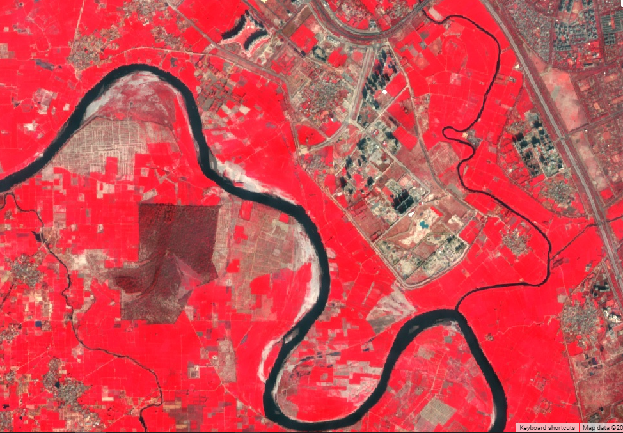
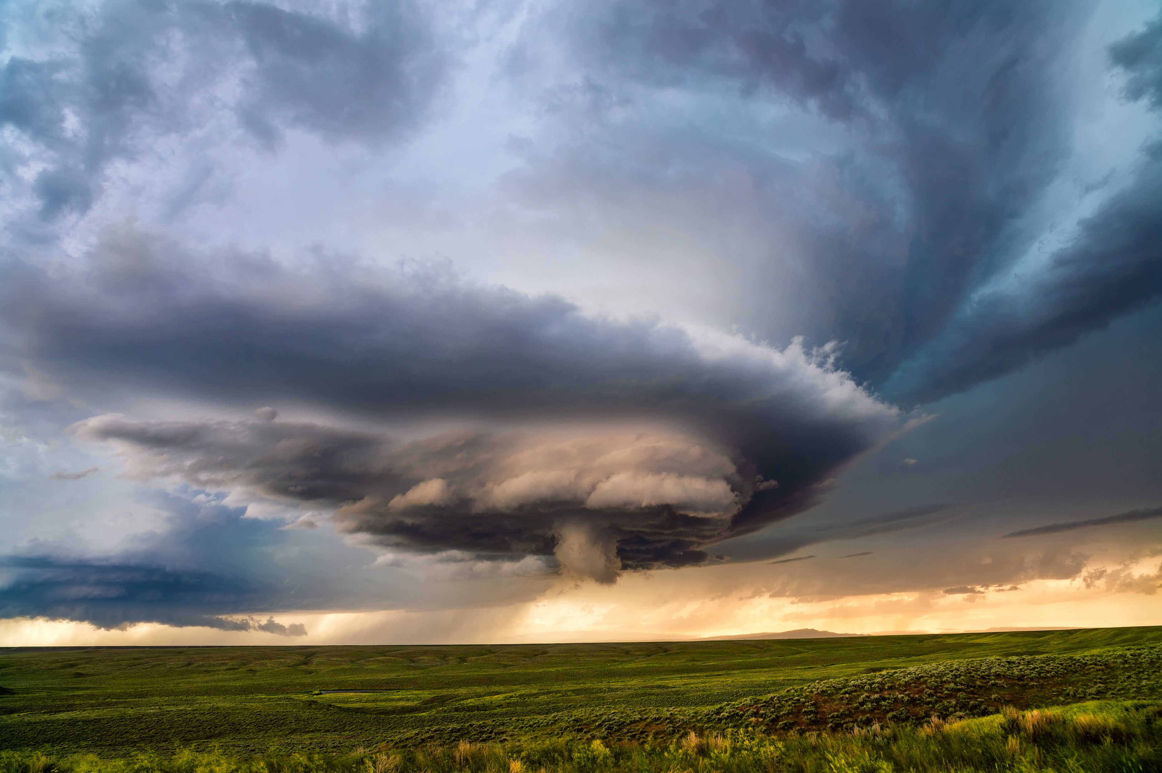
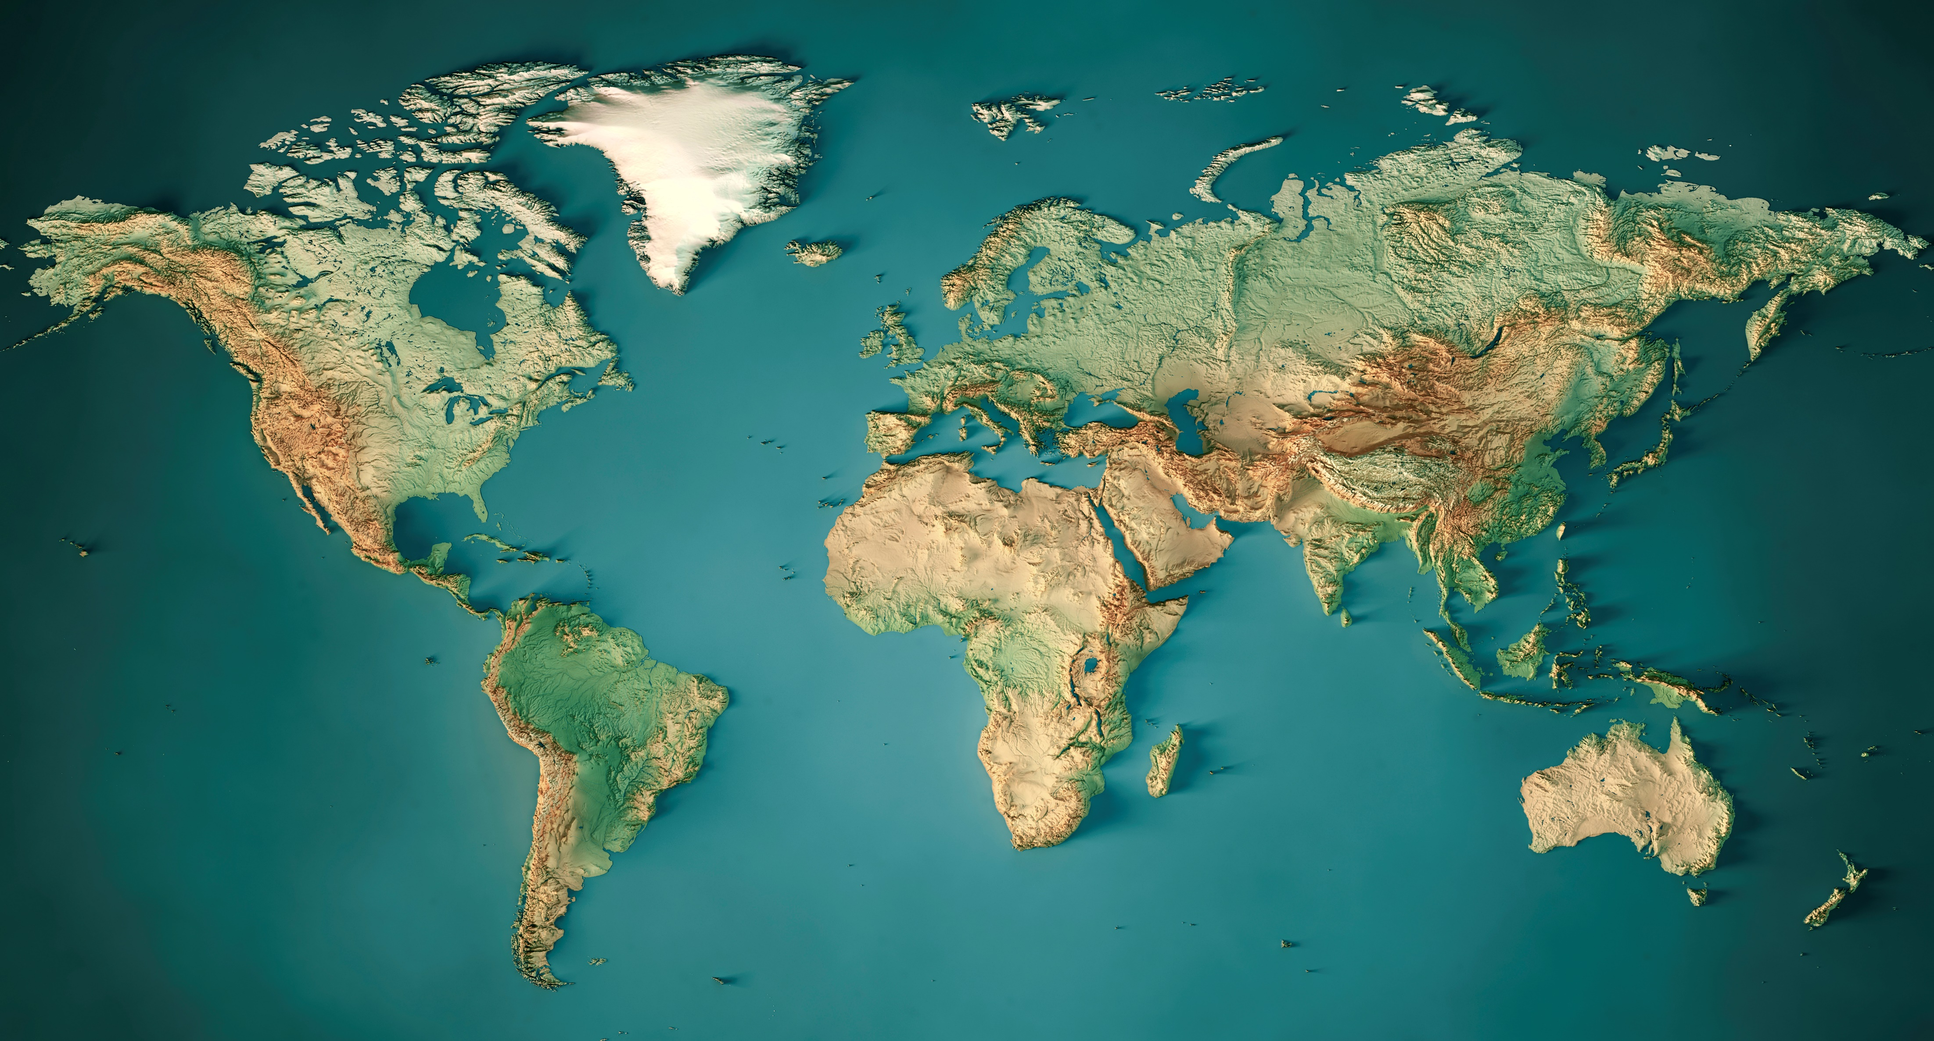
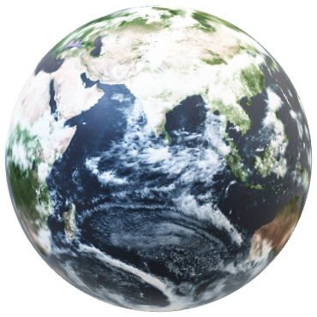

Outline
Introduction
Google Earth Engine Cloud-based platform combines multi-petabyte catalog of satellite imagery and geospatial datasets with large-scale geospatial analysis
Access over 40 plus years of data
The Earth Engine API is available in Python and JavaScript, making it easy to harness the power of Google’s cloud for your own geospatial analysis.
No need of high processing system, satellite data downloading, storage…

Slide 4
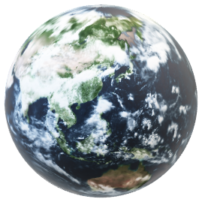

Outline
Datasets on Google Earth Engine
Satellite Imagery
Climate and Weather
  Landsat
  Sentinel
  MODIS
Geophysical
  Surface Temperature
  Climate
  Atmospheric
  Weather
  Terrain
  Land Cover
  Other Datasets
Google Earth Engine Cloud-based platform combines multi-petabyte catalog of satellite imagery and geospatial datasets with large-scale geospatial analysis
Access over 40 plus years of data
The Earth Engine API is available in Python and JavaScript, making it easy to harness the power of Google’s cloud for your own geospatial analysis.
No need of satellite data downloading, processing, storage…

Slide 5
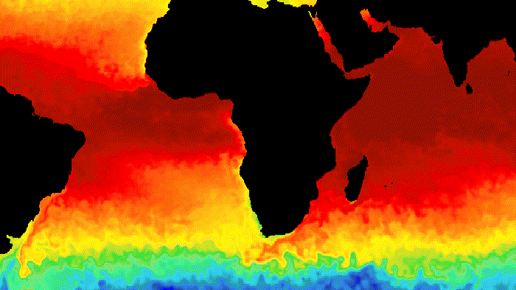
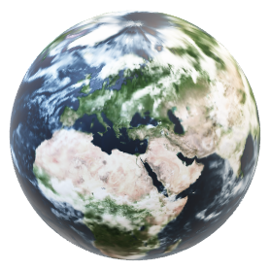
Datasets on Google Earth Engine
Climate and Weather
  Surface Temperature
  Climate
  Atmospheric
  Weather
HYCOM: Hybrid Coordinate Ocean Model, Water Temperature and Salinity
NOAA AVHRR Pathfinder Global 4km Sea Surface Temperature
Day/Night Land Surface Temperature and Emissivity Daily 1km

Slide 6
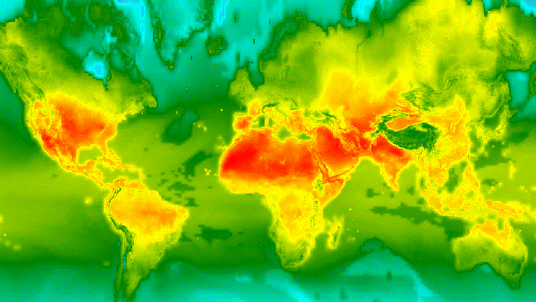

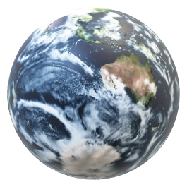
Datasets on Google Earth Engine
Climate and Weather
  Surface Temperature
  Climate
  Atmospheric
  Weather
Sentinel5P : CH4, NO2, Cloud (1.13 km)
Standardized Precipitation-Evapotranspiration Index database (55.36 km)
Global Change Observation Mission’s L3 Leaf Area Index (V1)
Drought Indices (4.6 km)

Slide 7
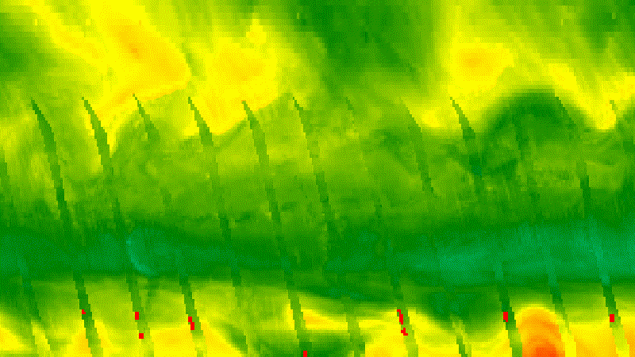
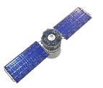
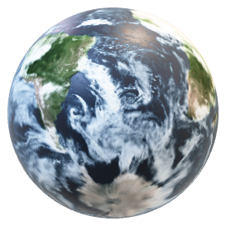
Datasets on Google Earth Engine
Climate and Weather
  Surface Temperature
  Climate
  Atmospheric
  Weather
Copernicus Atmosphere Monitoring Service (CAMS) (44.5km)
Total Ozone Mapping Spectrometer Data (111 km)
National Center for Atmospheric Research’s Reanalysis Data, Water Vapor (278 km)

Slide 8
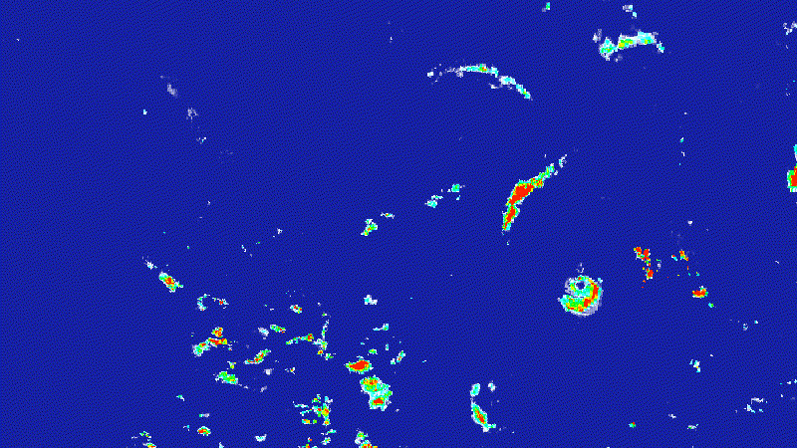
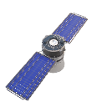
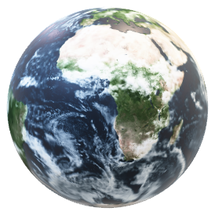
Datasets on Google Earth Engine
Climate and Weather
  Surface Temperature
  Climate
  Atmospheric
  Weather
NASA’s Daily Surface Weather and Climatological Summaries (1km)
Global Precipitation Measurement (11 km)
SMAP L4 Global 3-hourly 9-km Surface and Root Zone Soil Moisture (11 km)

Slide 9
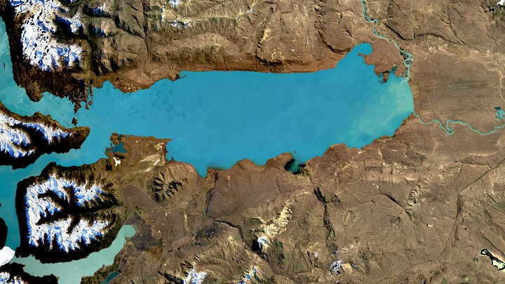
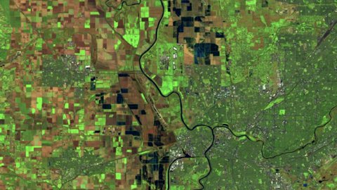
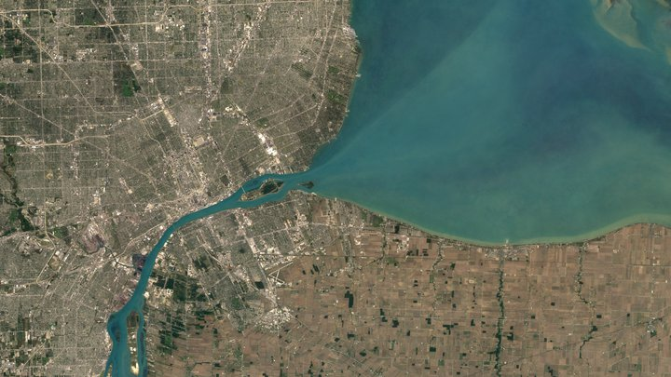
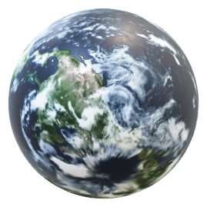

Datasets on Google Earth Engine
Satellite Imagery
Landsat 8
  Landsat
  Sentinel
  MODIS
  High Resolution Imagery
Landsat 7
Landsat 9

Slide 10
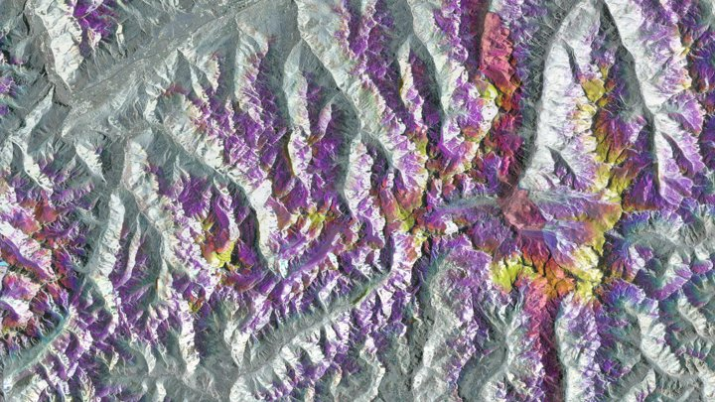
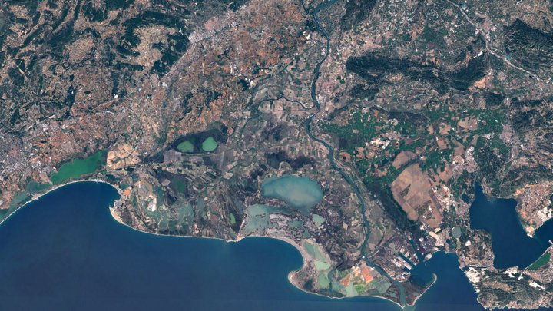
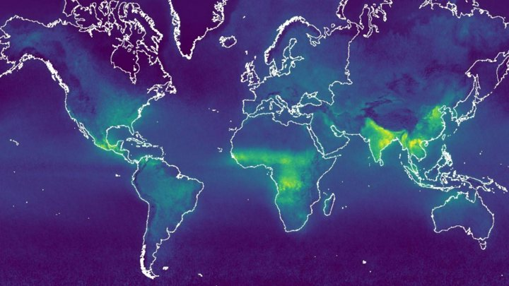
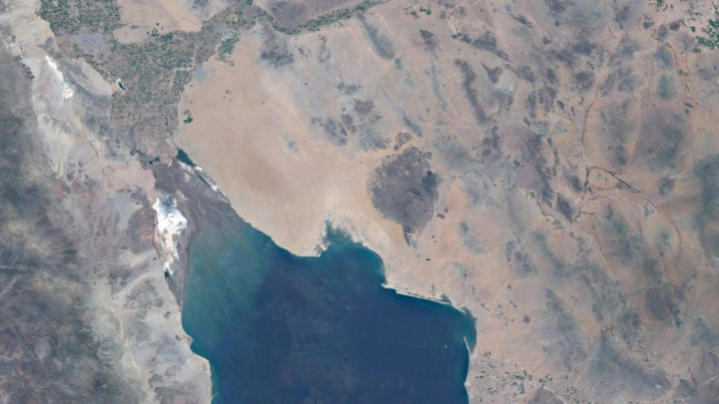
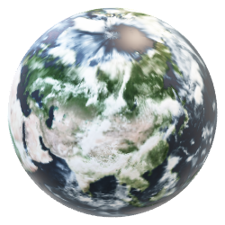
Datasets on Google Earth Engine
Satellite Imagery
  Landsat
  Sentinel
  MODIS
  High Resolution Imagery
Sentinel 1
Sentinel 2
Sentinel 5P
Sentinel 3

Slide 11
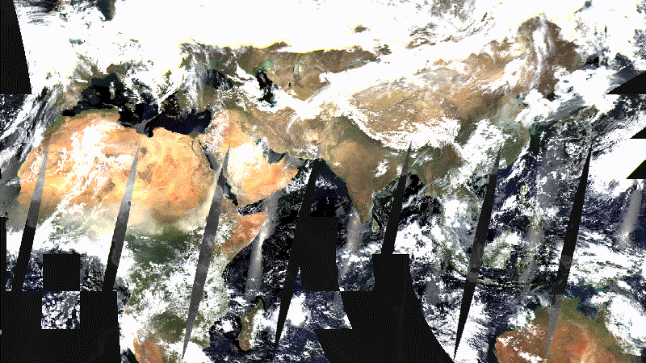
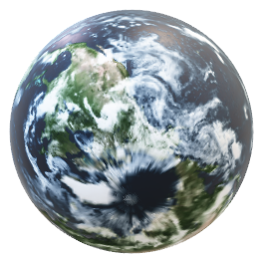

Datasets on Google Earth Engine
Satellite Imagery
  Landsat
  Sentinel
  MODIS
  High Resolution Imagery
MODI Daily Global reflectance 1KM , 500m, 250m
MODI Terra snow cover daily 500m
MODI Tera Land Surface Temperature 1km
MODI Terra vegetation indices 1km

Slide 12
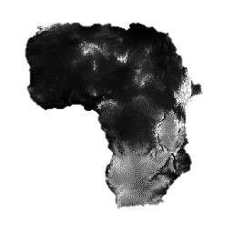
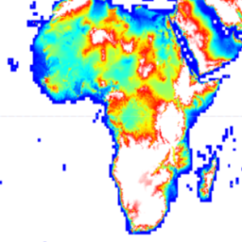
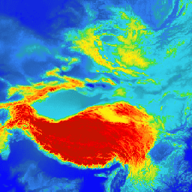
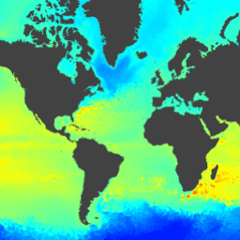
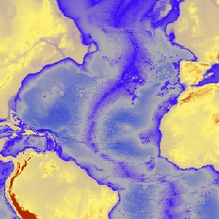
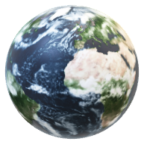

Copernicus DEM
Datasets on Google Earth Engine
Geophysical
  Terrain
  Land Cover
  Cropland
SRTM DEM
ASTER Global Emissivity Dataset
ETOPO
HYCOM Sea Surface Elevation
Google Earth Engine Cloud-based platform combines multi-petabyte catalog of satellite imagery and geospatial datasets with large-scale geospatial analysis
Access over 40 plus years of data
The Earth Engine API is available in Python and JavaScript, making it easy to harness the power of Google’s cloud for your own geospatial analysis.
No need of satellite data downloading, processing, storage…

Slide 13
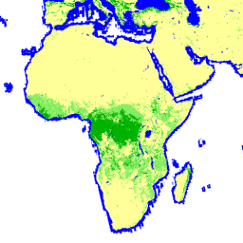
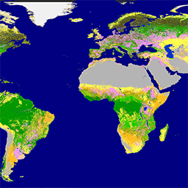
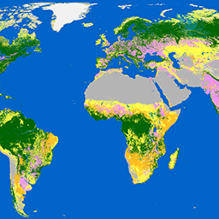
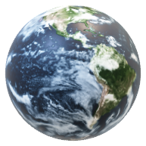

Global forest/ non forest area
Datasets on Google Earth Engine
Geophysical
  Terrain
  Land Cover
  Cropland
Copernicus Landuse Landcover 100m
ESA Landuse Landcover 10 m

Slide 14
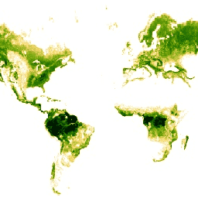
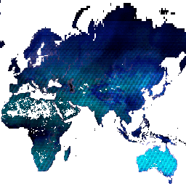
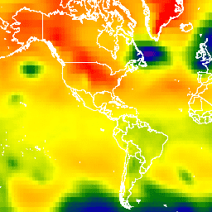
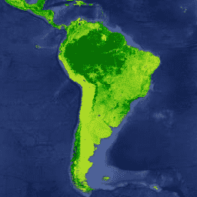
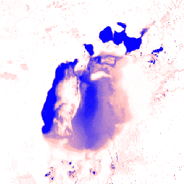

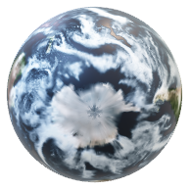
Forest canopy height dataset
927 m
Land Water Mask dataset
250 m
Datasets on Google Earth Engine
Geophysical
  Terrain
  Land Cover
  Other datasets
MODI’s Terra
Vegetation Continuous Fields
250 m
Global Surface Water dataset
30 m
Reference Elevation Model
of Antartica 2m
NCEP/NCAR Reanalysis Data,
Sea-Level Pressure 278 km

Slide 15
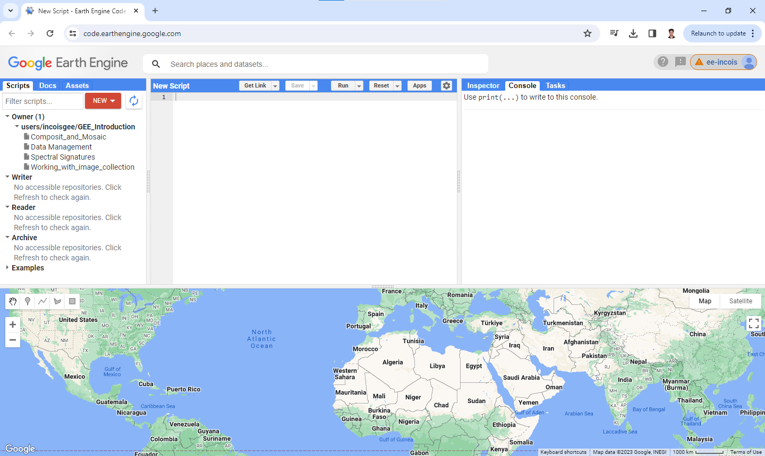
Forest canopy height dataset
927 m
Land Water Mask dataset
250 m
Working with Google Earth Engine
MODI’s Terra
Vegetation Continuous Fields
250 m
Global Surface Water dataset
30 m
Reference Elevation Model
of Antartica 2m
NCEP/NCAR Reanalysis Data,
Sea-Level Pressure 278 km

Slide 16
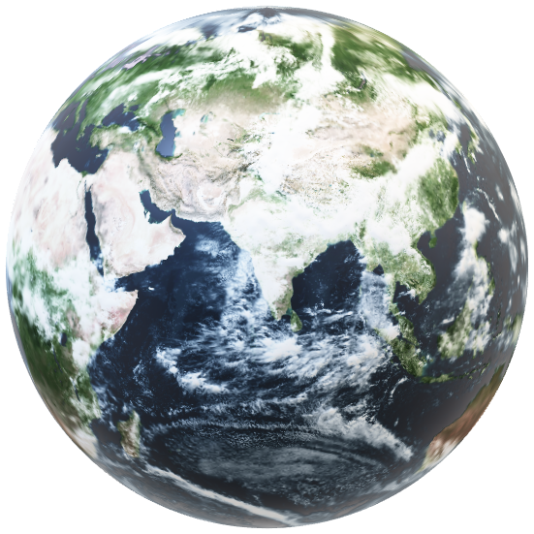
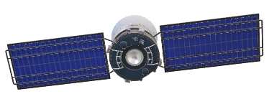
Thank you !

